Slide 1
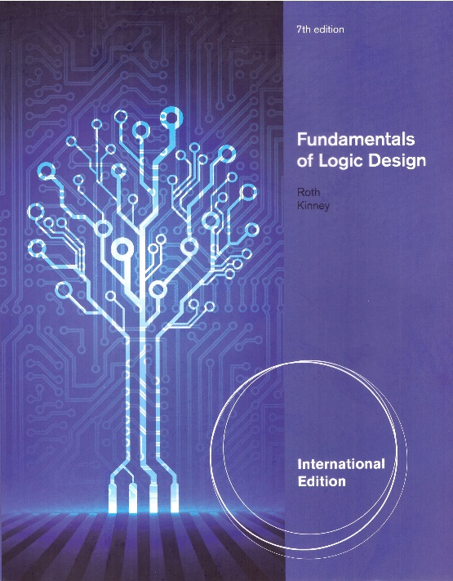
Unit 9
MULTIPLEXERS, DECODERS, AND PROGRAMMABLE LOGIC DEVICES
This chapter in the book includes:
Objectives
Study Guide
9.1 Introduction
9.2 Multiplexers
9.3 Three-State Buffers
9.4 Decoders and Encoders
9.5 Read-Only Memories
9.6 Programmable Logic Devices
9.7 Complex Programmable Logic Devices
9.8 Field Programmable Gate Arrays
Problems

Slide 2
Objectives
1. Explain the function of a multiplexer. Implement a multiplexer using gates.
2. Explain the operation of three-state buffers. Determine the resulting output when
three-state buffers outputs are connected together. Use three-state buffers to multiplex
signals onto a bus.
3. Explain the operation of a decoder and encoder. Use a decoder with added gates to
implement a set of logic functions. Implement a decoder or priority encoder using gates.
4. Explain the operation of a read-only memory (ROM). Use a ROM to implement a set of
logic functions.
5. Explain the operation of a programmable logic array (PLA). Use a PLA to implement
a set of logic functions. Given a PLA table or an internal connection diagram for a PLA,
determine the logic functions realized.
6. Explain the operation of a programmable array logic device (PAL).
Determine the programming pattern required to realize a set of logic function with a PAL.
7. Explain the operation of a complex programmable logic device (CPLD) and a field
programmable gate array (FPGA).
8. Use Shannon’s expansion theorem to decompose a switching function.

Slide 3
9.1 Introduction
Multiplexers (MUX)
Encoders and Decoders
Three-State Buffers
Read-Only Memories
Programmable Logic Devices (PLD)
- Programmable Logic Array (PLA)
- Programmable Array Logic (PAL)
Complex Programmable Logic Devices (CPLD)
Field-Programmable Gate Arrays (FPGA)

Slide 4
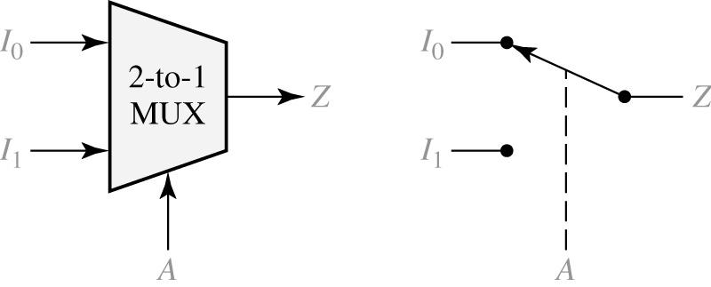
9.2 Multiplexers
Figure 9-1: The 2-to-1 Multiplexer
selection

Slide 5
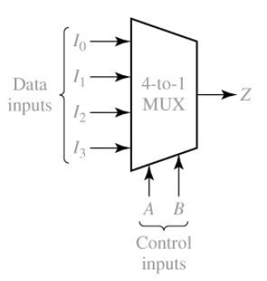
9.2 Multiplexers
Figure 9-2: The 4-to-1 Multiplexer

Slide 6
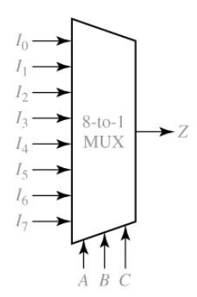
9.2 Multiplexers
Figure 9-2: The 8-to-1 Multiplexer

Slide 7
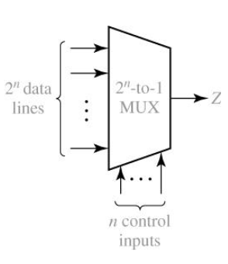
9.2 Multiplexers
Figure 9-2: The 2^{n}-to-1 Multiplexer

Slide 8
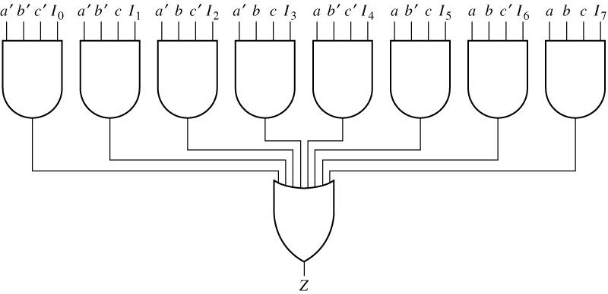
9.2 Multiplexers
Figure 9-3: Logic Diagram for 8-to-1 MUX
abc: SELECTION

Slide 9
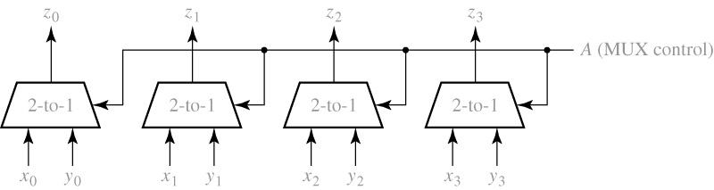
9.2 Multiplexers
Figure 9-6: Quad Multiplexer Used to Select Data

Slide 10
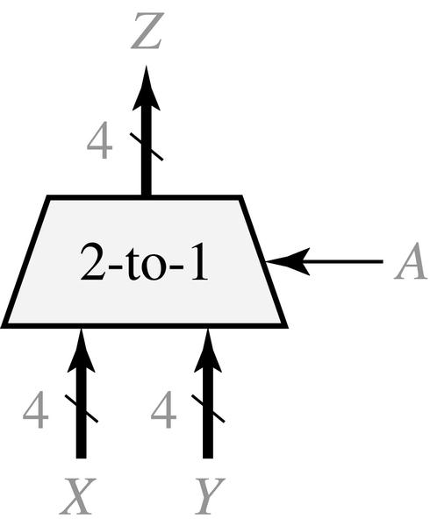
9.2 Multiplexers
Figure 9-7: Quad Multiplexer with Bus Inputs and Output
# = number of bits

Slide 11
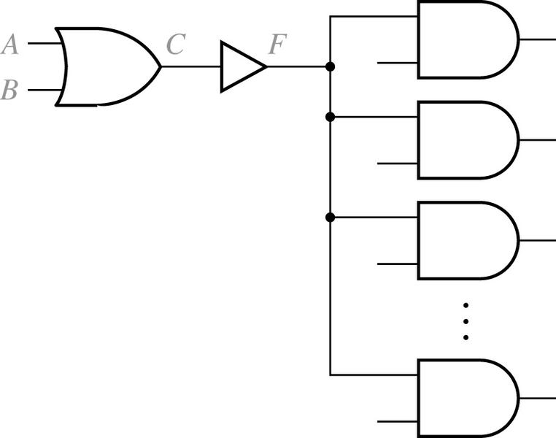
9.3 Three-State Buffers
Figure 9-10: Gate Circuit with Added Buffer
AMP
To feed enough power to multiple gates

Slide 12
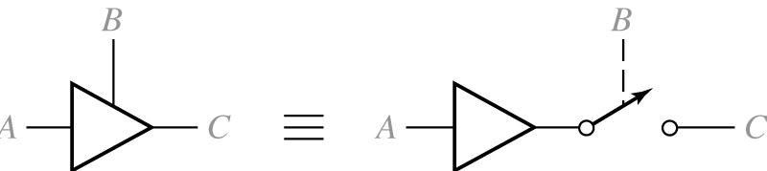
9.3 Three-State Buffers
Fig 9-11. Three-State Buffer
Disabled:
No signal

Slide 13
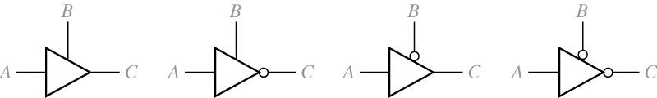
9.3 Three-State Buffers
Fig 9-12. Four Kinds of Three-State Buffers
B A | C
0 0 0 1 1 0 1 1 | Z Z 0 1
B A | C
0 0 0 1 1 0 1 1 | Z Z 1 0
B A | C
0 0 0 1 1 0 1 1 | 0 1 Z Z
B A | C
0 0 0 1 1 0 1 1 | 1 0 Z Z
(a)
(b)
(c)
(d)
Z: No signal

Slide 14
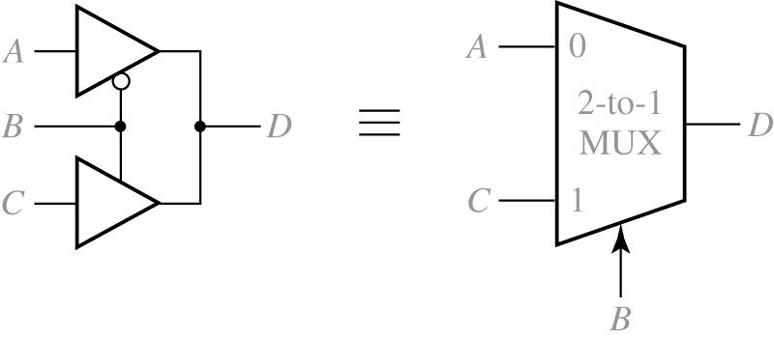
9.3 Three-State Buffers
Fig 9-13. Multiplexer Using Three-State Buffers

Slide 15
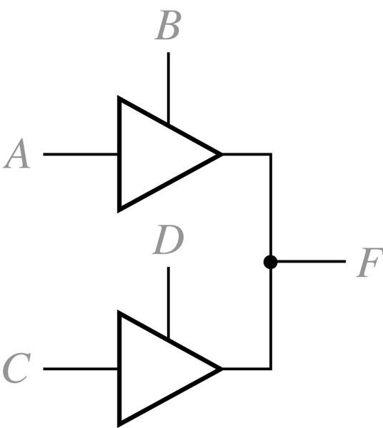
9.3 Three-State Buffers
Fig 9-14. Circuit with Two Three-State Buffers
F status
S1
S1
X
S2
0
1
Z
X
0
1
Z
X
X
X
X
X
0
X
0
X
X
1
1
X
0
1
Z
S2
X = Unknown
Z = Disabled

Slide 16
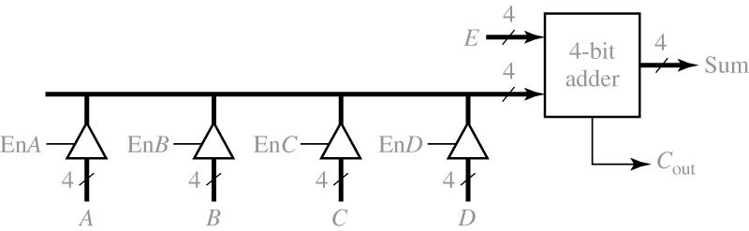
9.3 Three-State Buffers
Fig 9-15. 4-Bit Adder with Four Sources for One Operand
Addition of E & one of (A, B, C, D)

Slide 17
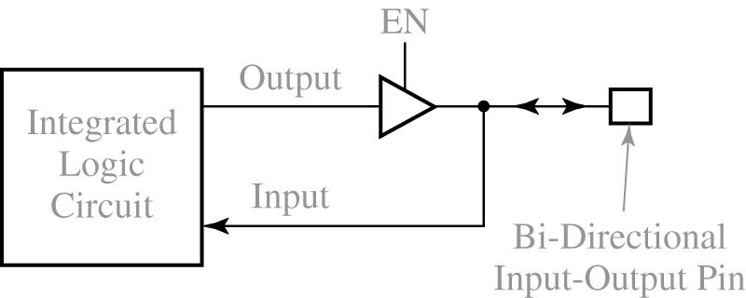
9.3 Three-State Buffers
Fig 9-16. Integrated Circuit with Bi-Directional Input/Output Pin
If disabled?

Slide 18
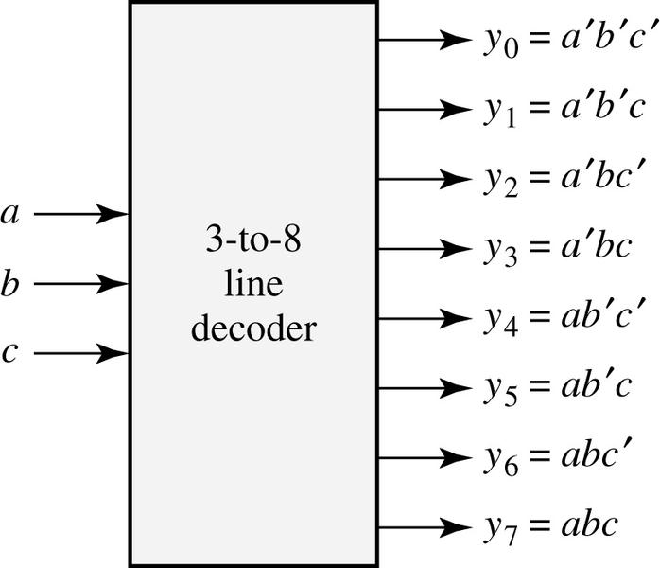
9.4 Decoders and Encoders
Fig 9-17. 3-to-8 Line Decoder
a b c
y₀
y₁
y₂
y₃
y₄
y₅
y₆
y₇
0 0 0
0 0 1
0 1 0
0 1 1
1 0 0
1 0 1
1 1 0
1 1 1
1
0
0
0
0
0
0
0
0
1
0
0
0
0
0
0
0
0
1
0
0
0
0
0
0
0
0
1
0
0
0
0
0
0
0
0
10
0
0
0
0
0
0
0
10
0
0
0
0
0
0
0
10
0
0
0
0
0
0
0
1

Slide 19
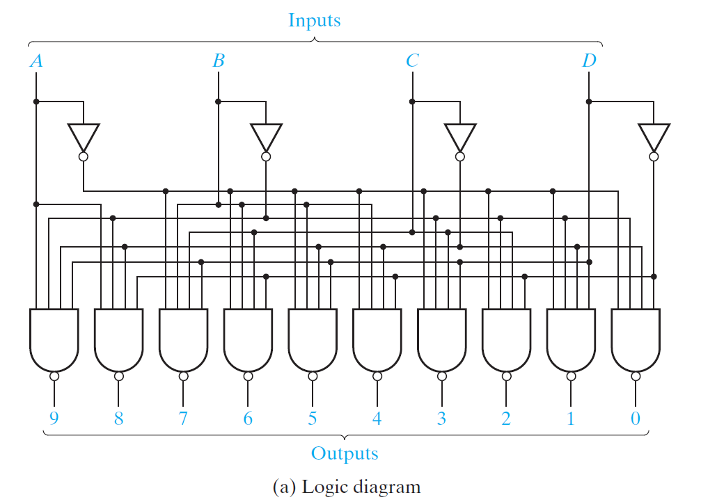
9.4 Decoders and Encoders
Fig 9-18. A 4-to-10 Line Decoder (1)
Only one output line will be 0
Notes:
Check for 8 (1000)

Slide 20
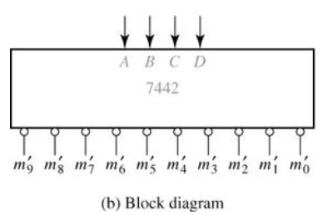
9.4 Decoders and Encoders
Fig 9-18. A 4-to-10 Line Decoder (2)
BCD Input
Decimal Output
A B C D
0
1
2
3
4
5
6
7
8
9
0 0 0 0
0 0 0 1
0 0 1 0
0 0 1 1
0 1 0 0
0 1 0 1
0 1 1 0
0 1 1 1
1 0 0 0
1 0 0 1
1 0 1 0
1 0 1 1
1 1 0 0
1 1 0 1
1 1 1 0
1 1 1 1
0
1
1
1
1
1
1
1
1
1
1
1
1
1
1
1
1
0
1
1
1
1
1
1
1
1
1
1
1
1
1
1
1
1
0
1
1
1
1
1
1
1
1
1
1
1
1
1
1
1
1
0
1
1
1
1
1
1
1
1
1
1
1
1
1
1
1
1
0
1
1
1
1
1
1
1
1
1
1
1
1
1
1
1
1
0
1
1
1
1
1
1
1
1
1
1
1
1
1
1
1
1
0
1
1
1
1
1
1
1
1
1
1
1
1
1
1
1
1
0
1
1
1
1
1
1
1
1
1
1
1
1
1
1
1
1
0
1
1
1
1
1
1
1
1
1
1
1
1
1
1
1
1
0
1
1
1
1
11
BCD (Binary Coded Decimal)
(c) Truth Table

Slide 21
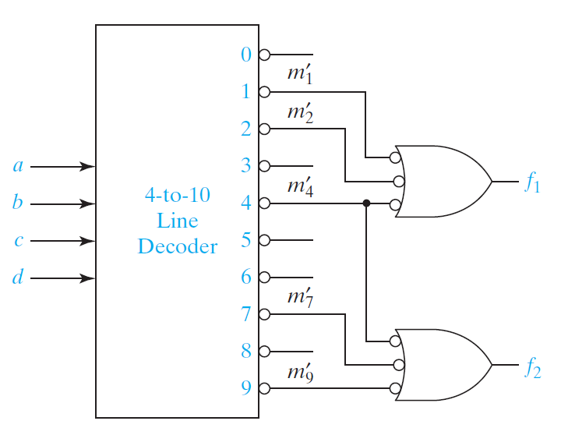
9.4 Decoders and Encoders
Fig 9-19. Realization of a Multiple-Output Circuit Using a Decoder

Slide 22
9.4 Decoders and Encoders
Encoding & Encoder
the opposite of decoding - the conversion of an m-bit input code to an n-bit output code with n £ m £ 2^{n} such that each valid code word produces a unique output code
Circuits that perform encoding are called encoders
An encoder has 2^{n} (or fewer) input lines and n output lines which generate the binary code corresponding to the input values
Typically, an encoder converts a code containing exactly one bit that is 1 to a binary code corresponding to the position in which the 1 appears

Slide 23
9.4 Decoders and Encoders
Encoder example: a Decimal-to-BCD encoder
Inputs: 10 lines (bits) corresponding to decimal digits 0 through 9, (D₀, …, D₉)
Outputs: 4 bits with BCD codes
Function: If input bit D_{i} is a 1, then the output (A₃, A₂, A₁, A₀) is the BCD code for i,
The truth table could be formed, but alternatively, the equations for each of the four outputs can be obtained directly.

Slide 24
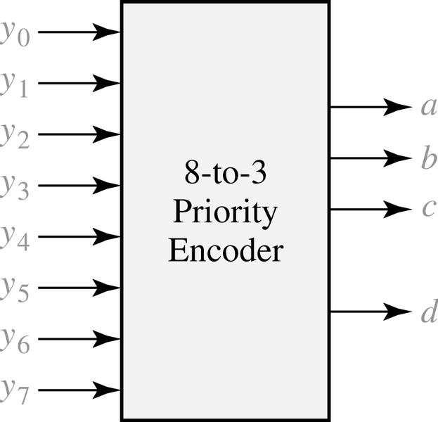
9.4 Decoders and Encoders
Fig 9-20. 8-to-3 Priority Encoder
y₀ | y₁ | y₂ | y₃ | y₄ | y₅ | y₆ | y₇ | a | b | c | d
0 1 X X X X X X X | 0 0 1 X X X X X X | 0 0 0 1 X X X X X | 0 0 0 0 1 X X X X | 0 0 0 0 0 1 X X X | 0 0 0 0 0 0 1 X X | 0 0 0 0 0 0 0 1 X | 0 0 0 0 0 0 0 0 1 | 0 0 0 0 0 1 1 1 1 | 0 0 0 1 1 0 0 1 1 | 0 0 1 0 1 0 1 0 1 | 0 1 1 1 1 1 1 1 1
d : distinguish
d = 1 if any input is 1
Who has the highest priority?

Slide 25
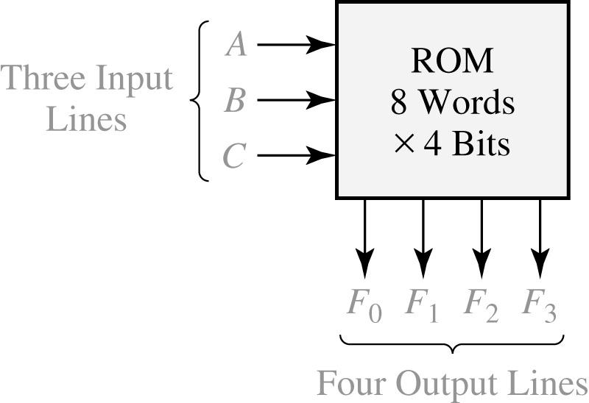
9.5 Read-Only Memories
Fig 9-21. An 8-Word x 4-Bit ROM
A
B
C
F₀
F₁
F₂
F₃
0
0
0
0
1
1
1
1
0
0
1
1
0
0
1
1
0
1
0
1
0
1
0
1
1
1
0
0
1
0
1
0
0
0
1
1
1
0
1
1
1
1
1
0
0
0
1
0
0
0
1
1
0
1
1
1
typical data stored in ROM
(2³ words of
4 bits each)
ADDRESS
DATA
(a) Block diagram
(b) Truth table for ROM

Slide 26
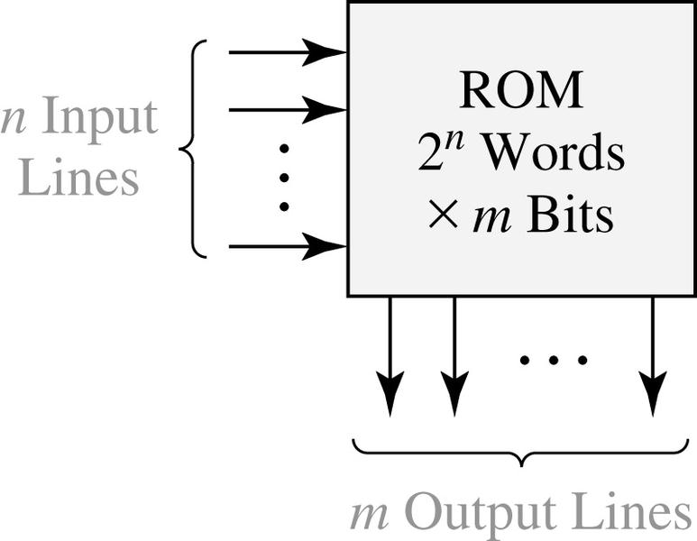
9.5 Read-Only Memories
Fig 9-22. Read-Only Memory with n Inputs and m Outputs
n input Variables |  |  |  | m output Variables
00 00 00 00 11 11 11 11 | · · · · · · · · · · · · · · · · · · · · · · · · · · · · · · · · · · | 00 01 10 11 00 01 10 11 |  |  | 100 010 101 110 001 110 011 111 | · · · · · · · · · · · · · · · · · · · · · · · · · · · · · · · · · · | 110 111 101 010 · · 011 110 000 101
typical data array stored
in ROM
(2^{n} words of
m bits each)

Slide 27
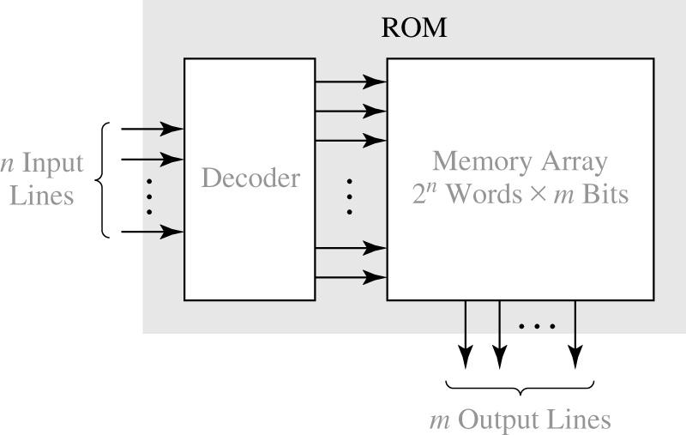
9.5 Read-Only Memories
Fig 9-23. Basic ROM Structure

Slide 28
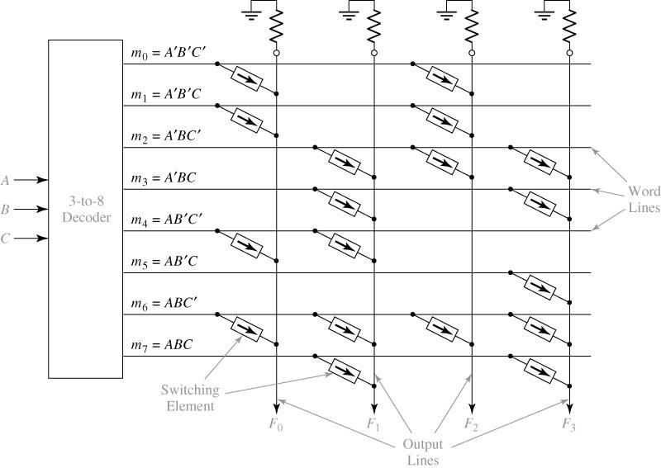
9.5 Read-Only Memories
Fig 9-24. An 8-Word x 4-Bit ROM

Slide 29
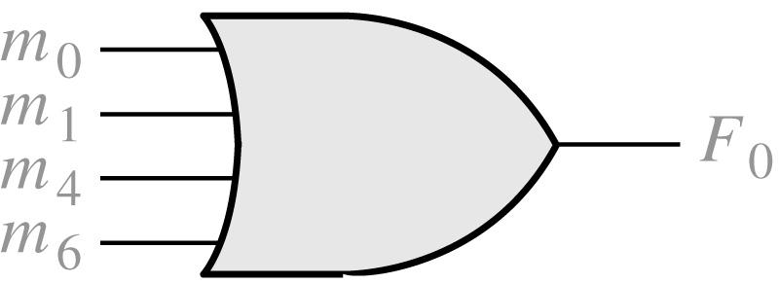
9.5 Read-Only Memories
Fig 9-25. Equivalent OR Gate for F₀

Slide 30
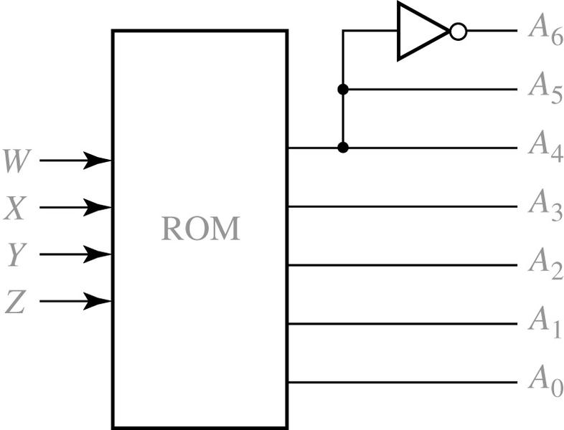
9.5 Read-Only Memories
Fig 9-26. Hexadecimal to ASCII Code Converter
Input |  |  |  | Hex Digit |  |  | ASCII Code for Hex Digit
W | X | Y | Z |  |  |  | A₆ | A₅ | A₄ | A₃ | A₂ | A₁ | A₀
0 0 0 0 0 0 0 0 1 1 1 1 1 1 1 1 | 0 0 0 0 1 1 1 1 0 0 0 0 1 1 1 1 | 0 0 1 1 0 0 1 1 0 0 1 1 0 0 1 1 | 0 1 0 1 0 1 0 1 0 1 0 1 0 1 0 1 |  | 0 1 2 3 4 5 6 7 8 9 A B C D E F |  | 0 0 0 0 0 0 0 0 0 0 1 1 1 1 1 1 | 1 1 1 1 1 1 1 1 1 1 0 0 0 0 0 0 | 1 1 1 1 1 1 1 1 1 1 0 0 0 0 0 0 | 0 0 0 0 0 0 0 0 1 1 0 0 0 0 0 0 | 0 0 0 0 1 1 1 1 0 0 0 0 0 1 1 1 | 0 0 1 1 0 0 1 1 0 0 0 1 1 0 0 1 | 0 1 0 1 0 1 0 1 0 1 1 0 1 0 1 0

Slide 31
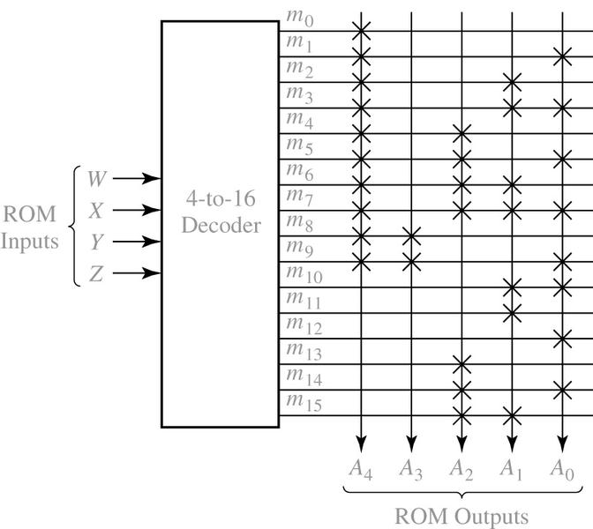
9.5 Read-Only Memories
Fig 9-27. ROM Realization of Code Converter

Slide 32
9.5 Read-Only Memories
ROM, DRAM, Flash memory
 | ROM | DRAM | Flash memory
writable | X | O | ???
Volatile | X | O | X
speed | fast | medium | slow
power | low | high | low
Why?

Slide 33
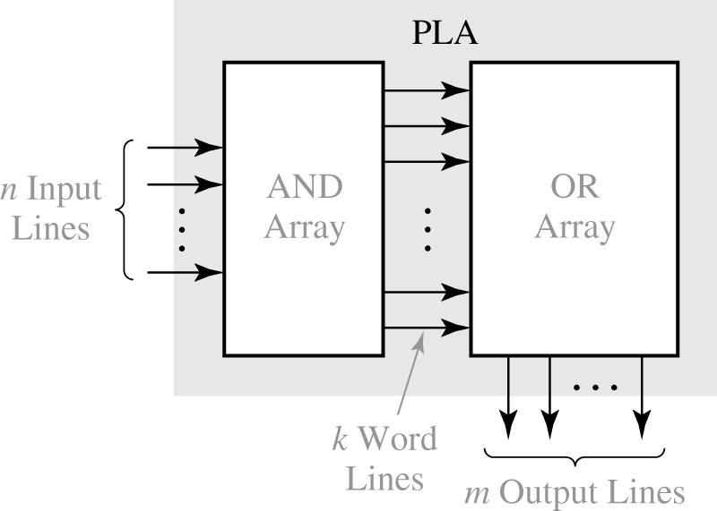
9.6 Programmable Logic Devices
Fig 9-28. Programmable Logic Array Structure

Slide 34
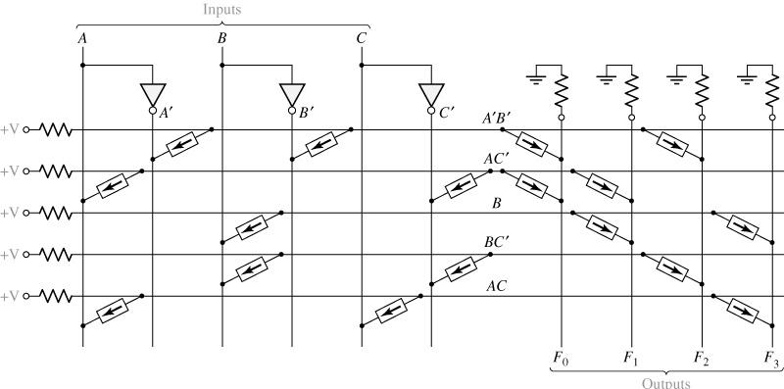
9.6 Programmable Logic Devices
Fig 9-29. PLA with Three Inputs, Five Product Terms, and Four Outputs

Slide 35
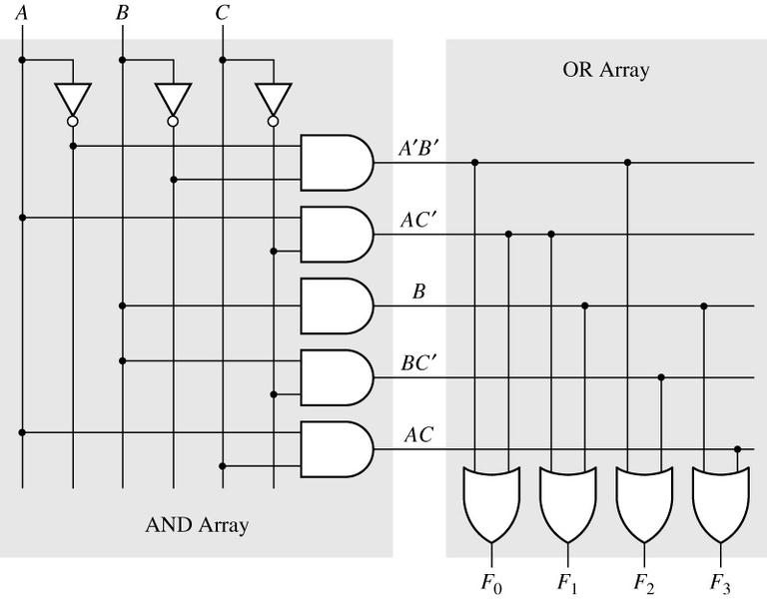
9.6 Programmable Logic Devices
Fig 9-30. AND-OR Array Equivalent to Figure 9-29

Slide 36
9.6 Programmable Logic Devices
Table 9-1. PLA Table for Figure 9-25
Product Term |  | Inputs |  |  |  | Outputs
 |  | A | B | C |  | F₀ | F₁ | F₂ | F₃
A’B’ AC’ B BC’ AC |  | 0 1 - - 1 | 0 - 1 1 - | - 0 - 0 1 |  | 1 1 0 0 0 | 0 1 1 0 0 | 1 0 0 1 0 | 0 0 1 0 1

Slide 37
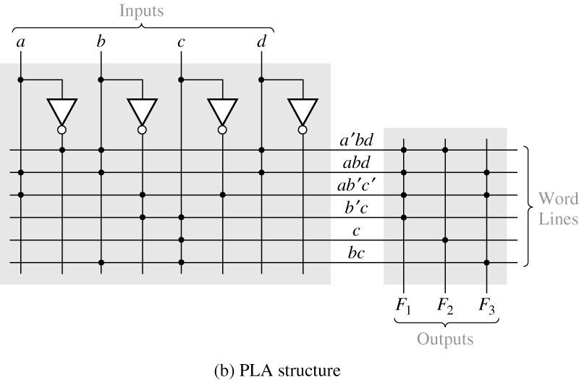
9.6 Programmable Logic Devices
Fig 9-31. PLA Realization of Equations (7-25b)
a | b | c | d |  | f₁ | f₂ | f₃
0 1 1 - - - | 1 1 0 0 - 1 | - - 0 1 1 1 | 1 1 - - - - |  | 1 1 1 1 0 0 | 1 0 0 0 1 0 | 0 1 1 0 0 1
(a) PLA table

Slide 38
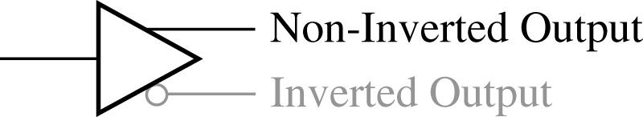
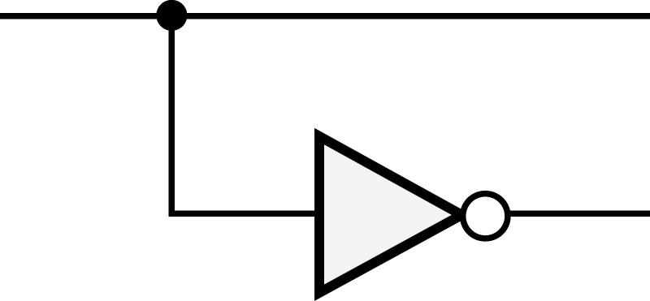
9.6 Programmable Logic Devices
Programmable Array Logic
The symbol of Figure 9-32(a)
logically equal

Slide 39
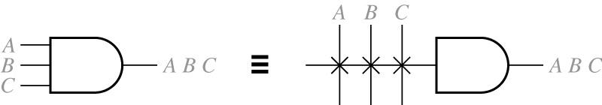
9.6 Programmable Logic Devices
Programmable Array Logic
Connections to the AND gate inputs in a PAL

Slide 40
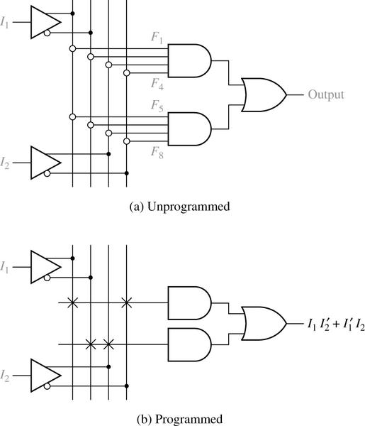
9.6 Programmable Logic Devices
Fig 9-32. PAL Segment

Slide 41
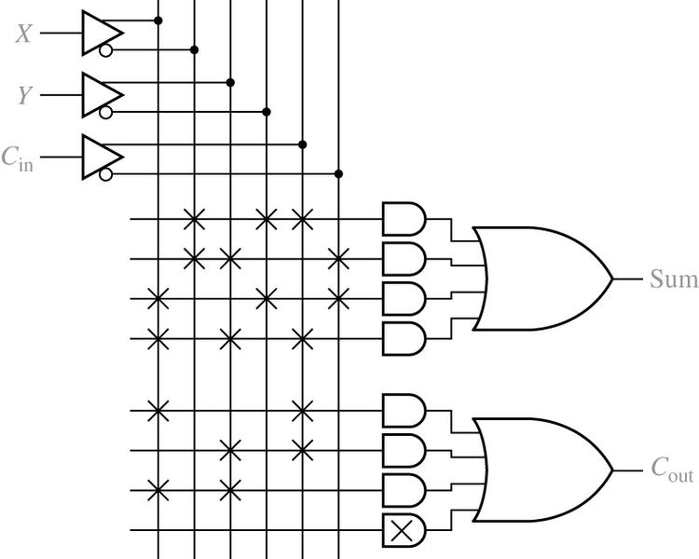
9.6 Programmable Logic Devices
Fig 9-33. Implementation of a Full Adder Using a PAL

Slide 42
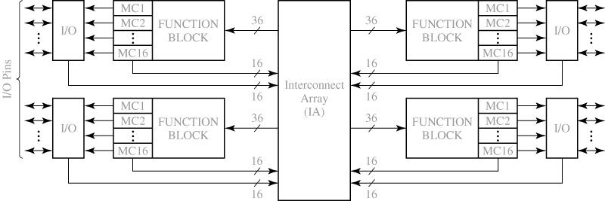
9.7 Complex Programmable Logic Devices
Fig 9-34. Architecture of Xilinx XCR3064XL CPLD

Slide 43
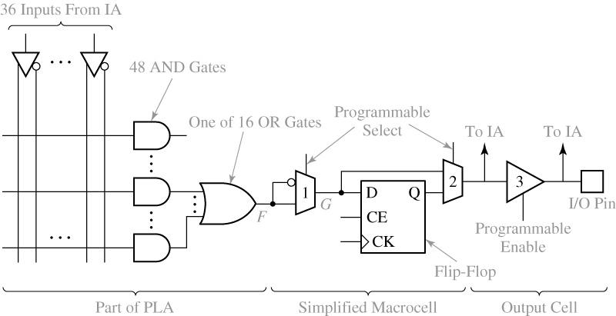
9.7 Complex Programmable Logic Devices
Fig 9-35. CPLD Function Block and Macrocell (A Simplified Version of XCR3064XL)

Slide 44
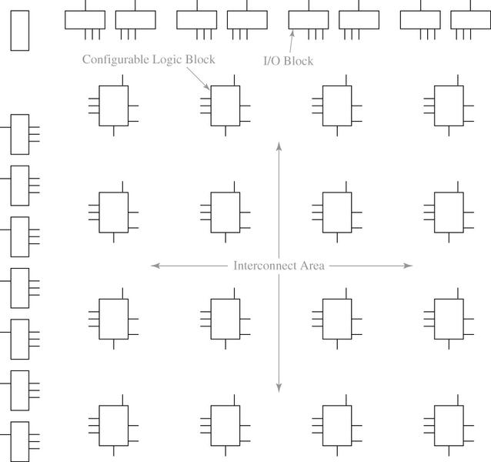
9.8 Field Programmable Gate Arrays
Fig 9-36. Layout of a Typical FPGA

Slide 45
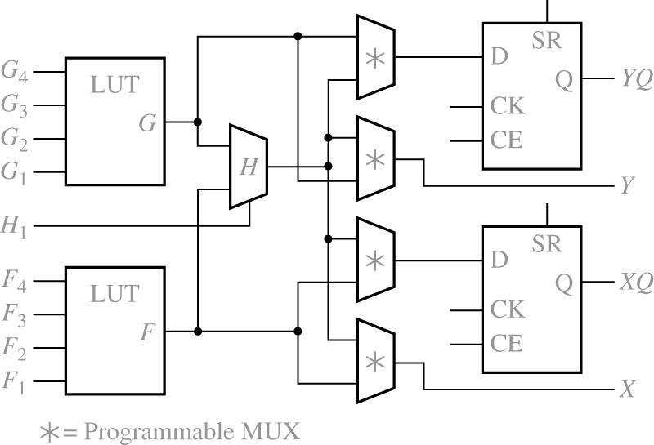
9.8 Field Programmable Gate Arrays
Fig 9-37. Simplified Configurable Logic Block (CLB)

Slide 46
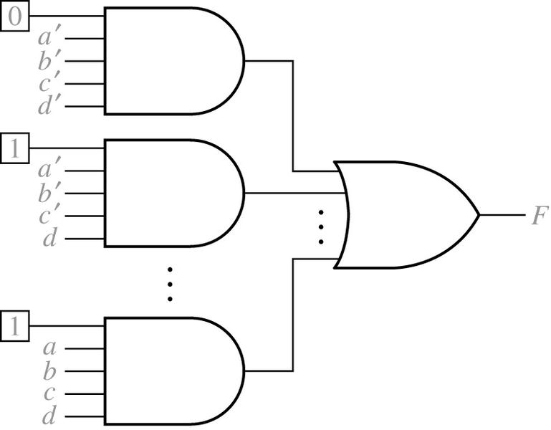
9.8 Field Programmable Gate Arrays
Fig 9-38. Implementation of a Lookup Table (LUT)
a | b | c | d |  | f
0 0 · · 1 | 0 0 · · 1 | 0 0 · · 1 | 0 1 · · 1 |  | 0 1 · · 1

Slide 47
9.8 Field Programmable Gate Arrays
Decomposition of switching Functions
Shannon’s expansion theorem

Slide 48
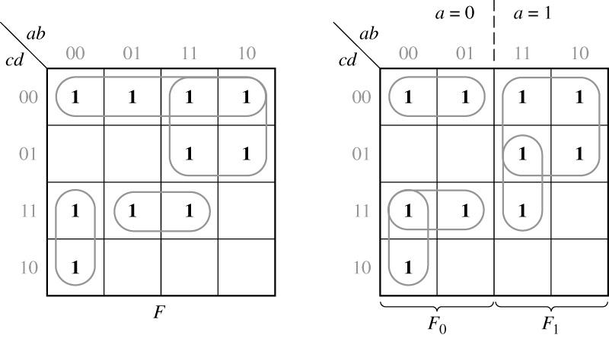
9.8 Field Programmable Gate Arrays
Fig 9-39. Function Expansion Using a Karnaugh Map

Slide 49
9.8 Field Programmable Gate Arrays
Decomposition of switching Functions
For a 5-variable function
For a 6-variable function

Slide 50
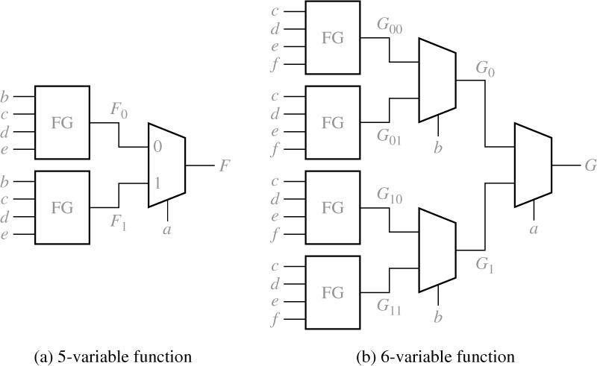
9.8 Field Programmable Gate Arrays
Fig 9-40. Realization of Five- and Six-Variable Functions
with Function Generators

